Slide 1
XML with Java
Advanced Java

Slide 2
What is XML
XML is a simple text-based language designed to store and transmit data in a plain text format. It stands for eXtensible Markup Language. Some salient features of XML:
XML is a markup language.
XML is a tag-based language like HTML.
XML tags are not predefined like HTML. You can define your own tags. That's why it's called an extensible language.
XML tags are designed to be self-describing.
XML is the W3C recommendation for data storage and transmission.

Slide 3
XML Parsers
What is a parser?
A program that analyses the grammatical structure of an input, with respect to a given formal grammar
The parser determines how a sentence can be constructed from the grammar of the language by describing the atomic elements of the input and the relationship among them
How should an XML parser work?

Slide 4
Parser - Read XML in Java
XML parsing refers to traversing an XML document to access or modify data.
An XML parser provides a way to access or modify data in an XML document.
Java provides many options for parsing XML documents:
Dom Parser: Parse an XML document by loading the entire document's contents and creating its full hierarchical tree in memory.
SAX Parser: Parse an XML document on event-based triggers, do not load the entire complete document into memory.
JDOM Parser: Parse an XML document in a similar way to a DOM parser but in an easier way.
StAX Parser: Parse an XML document in a similar way to the SAX parser but in a more efficient way.
…

Slide 5
DOM – Document Object Model

Slide 6
When should DOM be used?
You need to know a lot about the structure of an XML document.
You need to manipulate parts of the XML document (for example, sort certain elements).
You need to use the information in an XML document more than once
Advantage:
The DOM is a generic interface for manipulating XML document structures.
One of its design goals is to help Java code written for a DOM-compliant parser that will run on any other DOM-compliant parser without having to make any modifications.

Slide 7
DOM interfaces
DOM defines several interfaces. The most common interfaces:
Node: The basic data type of the DOM.
Element: Most of the objects you'll be dealing with are Elements. An Element is a Node.
Attr: Represents an attribute of an element.
Text: The actual content of the Element or Attr.
Document: Represents the entire XML document. A Document object is often called a DOM tree.

Slide 8
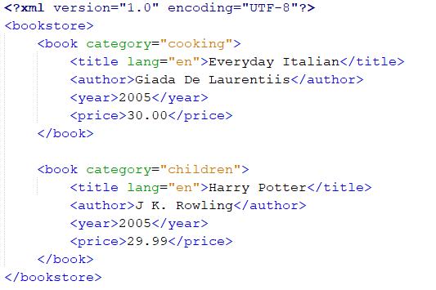
XML example
books.xml

Slide 9
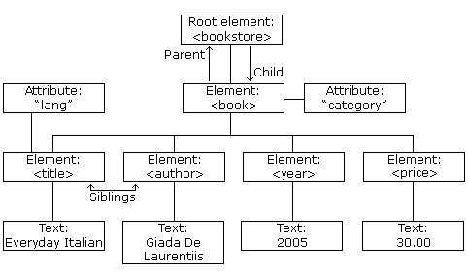
XML tree structure
books.xml

Slide 10
Common DOM methods
Document.getDocumentElement(): Returns the root element (the first child) of the document.
Node.getFirstChild(): Returns the first child of a given Node.
Node.getLastChild(): Returns the last child of a given Node.
Node.getNextSibling(): This method returns the next sibling of a given Node.
Node.getPreviousSibling(): This method returns the previous sibling of a given Node.
Node.getAttribute(attrName): For a given Node, it returns the attribute with the requested name attrName.

Slide 11
Steps to use DOM
Import XML related packages:
import org.w3c.dom.*;
import javax.xml.parsers.*;
import java.io.*;
Create a DocumentBuilder object: 2 substeps
DocumentBuilderFactory dbFactory = DocumentBuilderFactory.newInstance();
DocumentBuilder dBuilder = dbFactory.newDocumentBuilder();
Create a Document object from a file or a stream:
Document doc = dBuilder.parse(File inputFile);
StringBuilder xmlStringBuilder = new StringBuilder();
xmlStringBuilder.append("<?xml version="1.0"?> <class> </class>");
ByteArrayInputStream input = new ByteArrayInputStream(xmlStringBuilder.toString().getBytes("UTF-8"));
Document doc = builder.parse(input);

Slide 12
Steps to use DOM (cont)
Extract the root element:
Element root = doc.getDocumentElement();
//Node root = doc.getFirstChild();
Check attributes:
//return specific attribute
Node.getAttribute("attributeName");
//return a Map (table) of name/value pairs
Node.getAttributes();
Check child elements:
//return a list of children of the specified name
Node.getElementsByTagName("subelementName");
//return a list of all child nodes
Node.getChildNodes();

Slide 13
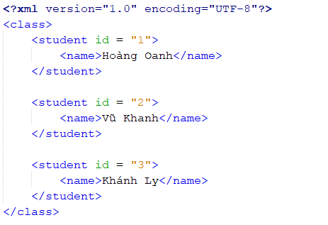
XML example
data.xml

Slide 14
DOM - Read XML documents
Create Student.java
public class Student {
private String id;
private String name;
//Constructors
//Getters and setters
@Override
public String toString() {
return "Student{" + "id=" + id + ", name=" + name + '}';
}
}

Slide 15
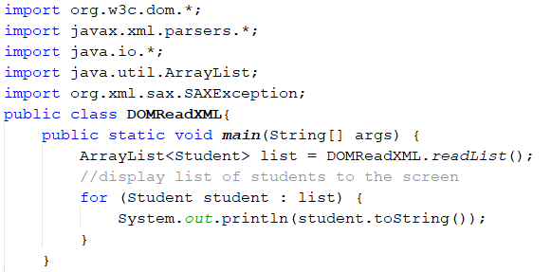
DOM - Read XML documents
Create a DOMReadXML.java file

Slide 16
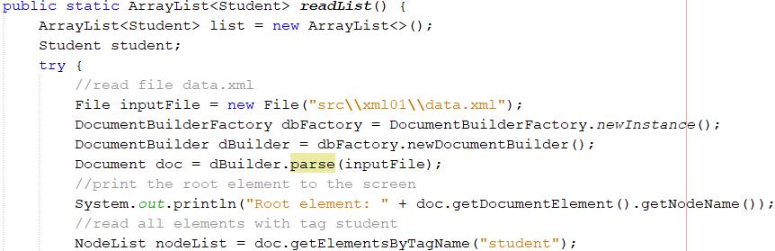
DOM - Read XML documents

Slide 17
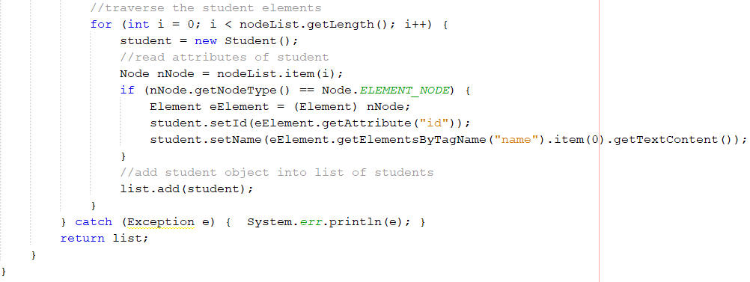

DOM - Read XML documents
The result:

Slide 18
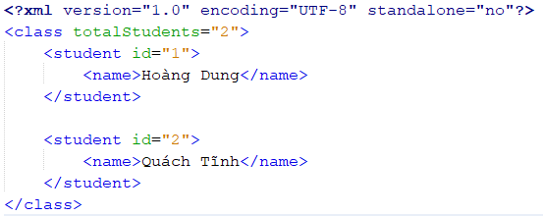
DOM - Create XML documents
To create the following XML document named example.xml

Slide 19
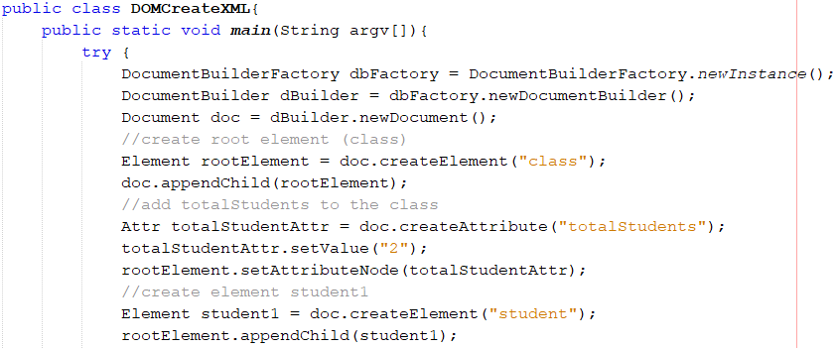
DOM - Create XML documents
Create a DOMCreateXML.java file

Slide 20
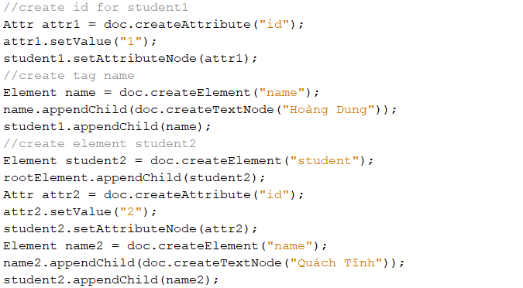
DOM - Create XML documents

Slide 21
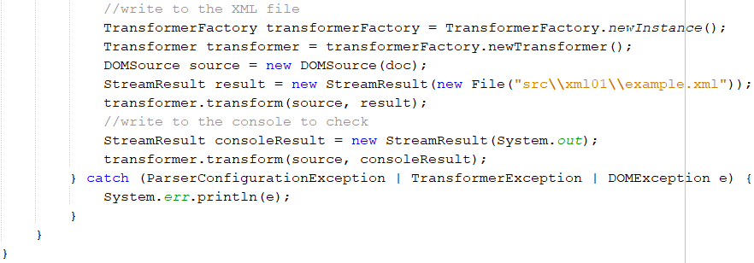

DOM - Create XML documents
read by DOMReadXML.java above
the result:

Slide 22
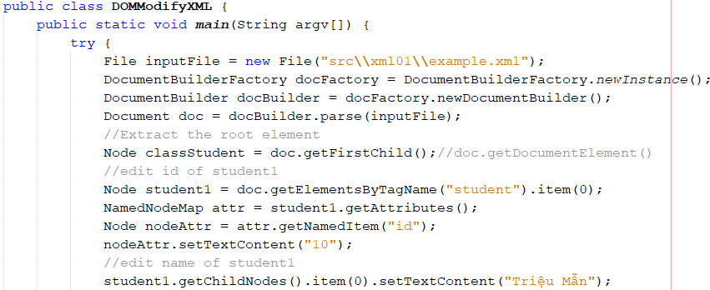
DOM - Modify XML documents
Edit the file example.xml above
Notes:
Để thêm sinh viên:
Element rootElement = doc.getDocumentElement();
Sau đó làm như tạo xml

Slide 23
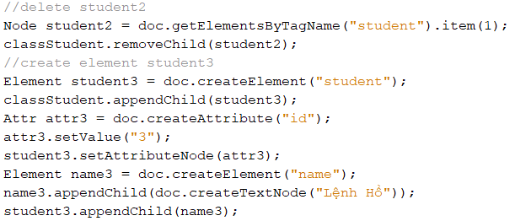
DOM - Modify XML documents

Slide 24
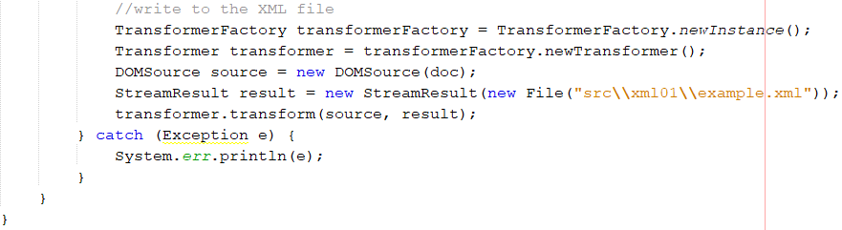

DOM - Modify XML documents
read by DOMReadXML.java above
the result:

Slide 25
SAX – Simple API for XML

Slide 26
SAX Parser
SAX = Simple API for XML
XML is read sequentially
When a parsing event happens, the parser invokes the corresponding method of the corresponding handler
The handlers are programmer’s implementation of standard Java API (i.e., interfaces and classes)
Similar to an I/O-Stream, goes in one direction

Slide 27
Implementing the Content Handler
A SAX parser invokes methods such as startDocument, endDocument, startElement and endElement of its content handler as it runs
In order to react to parsing events we must:
implement the ContentHandler interface
set the parser’s content handler with an instance of our ContentHandler implementation
An easy way to implement the ContentHandler interface is to extend DefaultHandler

Slide 28
When should SAX be used?
SAX parser does not load the complete XML into memory
It parses the XML by firing different events and when it encounters different elements like: opening tag, closing tag, data character, comment etc (an event-based parser)
To read XML documents with SAX Parser we need to create a class that extends the DefaultHandler class.
The DefaultHandler class provides the following different methods:
startElement(): trigger this event when an opening tag is encountered.
endElement(): fires this event when a closing tag is encountered.
characters(): trigger this event when it encounters some text data

Slide 29
XML example
data.xml
Start Document

Slide 30
XML example
data.xml
Start root Element
End root Element

Slide 31
XML example
data.xml
End Element
Start Element

Slide 32
XML example
data.xml
Attribute

Slide 33
XML example
data.xml
End Element
Start Element
Characters

Slide 34
SAX - Read XML documents
Create Student.java
public class Student {
private String id;
private String name;
//Constructors
//Getters and setters
@Override
public String toString() {
return "Student{" + "id=" + id + ", name=" + name + '}';
}
}

Slide 35
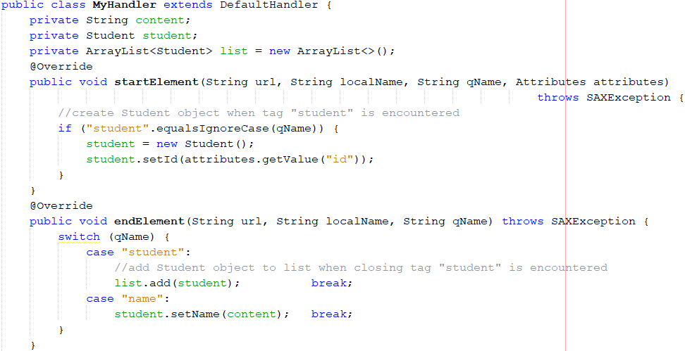
SAX - Read XML documents
Create a MyHandler.java file

Slide 36
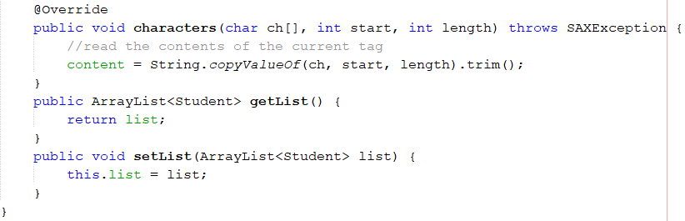
SAX - Read XML documents

Slide 37
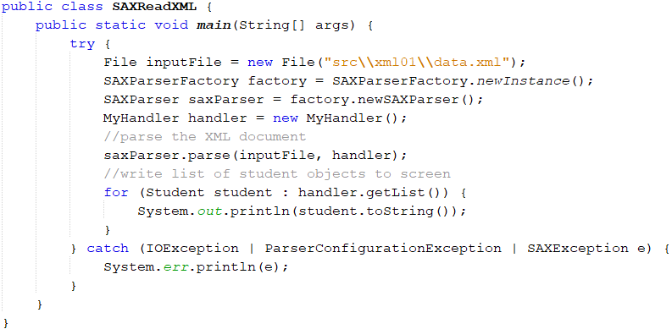

SAX - Read XML documents: main method
The result:

Slide 38
SAX vs. DOM

Slide 39
Parser Efficiency
The DOM object built by DOM parsers is usually complicated and requires more memory storage than the XML file itself
A lot of time is spent on construction before use
For some very large documents, this may be impractical
SAX parsers store only local information that is encountered during the serial traversal
Hence, programming with SAX parsers is, in general, more efficient

Slide 40
Node Navigation
SAX parsers do not provide access to elements other than the one currently visited in the serial (DFS) traversal of the document
In particular,
They do not read backwards
They do not enable access to elements by ID or name
DOM parsers enable any traversal method
Hence, using DOM parsers is usually more comfortable

Slide 41
More DOM Advantages
DOM object ⇔ compiled XML
You can save time and effort if you send and receive DOM objects instead of XML files
But, DOM object are generally larger than the source
DOM parsers provide a natural integration of XML reading and manipulating
e.g., “cut and paste” of XML fragments

Slide 42
Which should we use? DOM vs. SAX
If your document is very large and you only need a few elements – use SAX
If you need to manipulate (i.e., change) the XML – use DOM
If you need to access the XML many times – use DOM (assuming the file is not too large)

Slide 43


Slide 44

Thank you!

